Slide 1
Database
Query Optimization

Slide 2
Outline
Introduction
Materialization and On-the-fly
Join over Two Tables
Join over Multiple Tables

Slide 3
Introduction
Find the name of all students with age greater than 20 who take 231.
After users write SQL statements,
  They want to obtain the results quickly
  E.g., student (sid, sname, age)
  take (sid, cid)
  select sname
  from student S, take T
  where S.sid = T.sid
  and T.cid = “231”
  and S.age > 20
However, there are many ways to obtain the results

Slide 4
π_{sname}(σ_{cid=231∧age>20}(Take _{Take.sid=Student.sid} Student))
SQL
select sname
from student S, take T
where S.sid = T.sid
and T.cid = “231”
and S.age > 20
Translate the query to relational algebra operations
π_{sname}(σ_{cid=231∧age>20}(Take _{Take.sid=Student.sid} Student))

Slide 5
Evaluation Plan 1
π_{sname}(σ_{cid=231∧age>20}(Take _{Take.sid=Student.sid} Student))
Evaluation plan
Nodes are relational operators or tables
Edges point to where the input comes from
sname
icd=231
Age>20
T.sid=S.sid
Take T
Student S

Slide 6
Evaluation Plan 2
π_{sname}(σ_{cid=231∧age>20}(Take _{Take.sid=Student.sid} Student))
sname
T.sid=S.sid
cid=231
Age>20
Take T
Student S

Slide 7
Evaluation Plan 3
π_{sname}(σ_{cid=231∧age>20}(Take _{Take.sid=Student.sid} Student))
sname
cid=231
T.sid=S.sid
age>20
Take T
Student S

Slide 8
Evaluation Plan 4
π_{sname}(σ_{cid=231∧age>20}(Take _{Take.sid=Student.sid} Student))
sname
age>20
sid=sid
icd=231
Student S
Take T

Slide 9
π_{sname}(σ_{cid=231∧age>20}(Take _{Take.sid=Student.sid} Student))
DBMS’s job is to optimize the users’ query by
  Converting the query to a number of evaluation plans
  Estimating the cost of each evaluation plan
  Finding the evaluation plan with the lowest cost

Slide 10
Outline
Introduction
Materialization and On-the-fly
Join over Two Tables
Join over Multiple Tables

Slide 11
Materialization and On-the-fly
π_{sname}(σ_{cid=231∧age>20}(Take _{Take.sid=Student.sid} Student))
Let op1 and op2 be two relational algebra operations, and op1 is performed on the result of op2
The evaluation of op1 is on-the-fly if the result of op2 is directly sent to op1 (i.e, not stored in a temporary file)
It is materialized if that result is stored in a temporary file first
On-the-fly evaluation is called pipelined evaluation
On-the-fly can be more efficient than materialized

Slide 12
Materialization and On-the-fly
π_{sname}(σ_{cid=231∧age>20}(Take _{Take.sid=Student.sid} Student))
Materialization
On-the-fly

Slide 13
Materialization
π_{sname}(σ_{cid=231∧age>20}(Take _{Take.sid=Student.sid} Student))
Disk
Student
Take
sid | sname | age
100 | Raymond | 20
200 | Peter | 21
sid | cid
100 | 231
200 | 231
200 | 170
sid | sname | age | cid
100 | Raymond | 20 | 231
200 | Peter | 21 | 231
200 | Peter | 21 | 170
Materialization
Reading
Writing
Memory
Join
sid | sname | age | cid
100 | Raymond | 20 | 231
200 | Peter | 21 | 231
200 | Peter | 21 | 170
sid | sname | age
100 | Raymond | 20
200 | Peter | 21
sid | cid
100 | 231
200 | 231
200 | 170

Slide 14
Materialization
π_{sname}(σ_{cid=231∧age>20}(Take _{Take.sid=Student.sid} Student))
Disk
Student
Take
sid | sname | age
100 | Raymond | 20
200 | Peter | 21
sid | cid
100 | 231
200 | 231
200 | 170
sid | sname | age | cid
100 | Raymond | 20 | 231
200 | Peter | 21 | 231
200 | Peter | 21 | 170
Memory

Slide 15
Materialization
π_{sname}(σ_{cid=231∧age>20}(Take _{Take.sid=Student.sid} Student))
Disk
Student
Take
sid | sname | age
100 | Raymond | 20
200 | Peter | 21
sid | cid
100 | 231
200 | 231
200 | 170
sid | sname | age | cid
100 | Raymond | 20 | 231
200 | Peter | 21 | 231
200 | Peter | 21 | 170
Reading
Output to the screen
Memory
π_{sname}
σ_{cid=231∧age>20}
sid | sname | age | cid
100 | Raymond | 20 | 231
200 | Peter | 21 | 231
200 | Peter | 21 | 170
sid | sname | age | cid
200 | Peter | 21 | 231
sname
Peter

Slide 16
Materialization and On-the-fly
π_{sname}(σ_{cid=231∧age>20}(Take _{Take.sid=Student.sid} Student))
Materialization
On-the-fly

Slide 17
On-the-fly
π_{sname}(σ_{cid=231∧age>20}(Take _{Take.sid=Student.sid} Student))
Disk
Student
Take
sid | sname | age
100 | Raymond | 20
200 | Peter | 21
sid | cid
100 | 231
200 | 231
200 | 170
Reading
Memory
Join
sid | sname | age | cid
100 | Raymond | 20 | 231
200 | Peter | 21 | 231
200 | Peter | 21 | 170
sid | sname | age
100 | Raymond | 20
200 | Peter | 21
sid | cid
100 | 231
200 | 231
200 | 170

Slide 18
On-the-fly
π_{sname}(σ_{cid=231∧age>20}(Take _{Take.sid=Student.sid} Student))
Disk
Student
Take
sid | sname | age
100 | Raymond | 20
200 | Peter | 21
sid | cid
100 | 231
200 | 231
200 | 170
Output to the screen
Memory
π_{sname}
σ_{cid=231∧age>20}
sid | sname | age | cid
100 | Raymond | 20 | 231
200 | Peter | 21 | 231
200 | Peter | 21 | 170
sid | sname | age | cid
200 | Peter | 21 | 231
sname
Peter

Slide 19
Outline
Introduction
Materialization and On-the-fly
Join over Two Tables
Join over Multiple Tables

Slide 20
Example Schema
Student: 500 pages, 80 tuples/page, 50 bytes/tuple
Take: 1000 pages, 100 tuples/page, 40 bytes/tuple
- 200 courses in table Take
- 1, 2, …, 40 in attribute Age
of table Student
Assuming the following table sizes:
  Student: 500 pages, 80 tuples/page, 50 bytes/tuple
  Take: 1000 pages, 100 tuples/page, 40 bytes/tuple
Assume that there are 200 courses in table Take
Find the name of all students with age greater than 20 who take 231.
Translate the query to relational algebra operations
π_{sname}(σ_{cid=231∧age>20}(Take _{Take.sid=Student.sid} Student))

Slide 21
Example Schema
Student: 500 pages, 80 tuples/page, 50 bytes/tuple
Take: 1000 pages, 100 tuples/page, 40 bytes/tuple
- 200 courses in table Take
- 1, 2, …, 40 in attribute Age
of table Student
Join
  Simple-nested loop Join
  Block-nested loop Join
  Sort-Merge Join
  Index-Nested loop Join

Slide 22
Evaluation Plan 1
Student: 500 pages, 80 tuples/page, 50 bytes/tuple
Take: 1000 pages, 100 tuples/page, 40 bytes/tuple
- 200 courses in table Take
- 1, 2, …, 40 in attribute Age
of table Student
We do NOT calculate the cost of writing the output. Why?
(On-the-fly)
sname
(On-the-fly)
Suppose that Student is the outer relation
cid=231
age>20
(Simple-Nested
Loop Join)
Cost = 500+500*1000
=500500 pages
T.sid=S.sid
Take T
Student S
(File scan)
(File scan)

Slide 23
Evaluation Plan 1
Student: 500 pages, 80 tuples/page, 50 bytes/tuple
Take: 1000 pages, 100 tuples/page, 40 bytes/tuple
- 200 courses in table Take
- 1, 2, …, 40 in attribute Age
of table Student
(On-the-fly)
sname
(On-the-fly)
Suppose that Take is the outer relation
cid=231
age>20
(Simple-Nested
Loop Join)
Cost = 1000+1000*500
=501000 pages
T.sid=S.sid
If Student is the outer relation,
then the cost is 500500 pages
If Take is the outer relation,
then the cost is 501000 pages
Which one should we choose?
Take T
Student S
(File scan)
(File scan)

Slide 24
Evaluation Plan 2
Student: 500 pages, 80 tuples/page, 50 bytes/tuple
Take: 1000 pages, 100 tuples/page, 40 bytes/tuple
- 200 courses in table Take
- 1, 2, …, 40 in attribute Age
of table Student
sname
(On-the-fly)
(Simple-Nested
Loop Join)
T.sid=S.sid
(Write to temp T1 )
cid=231
age>20
(Write to
Temp T2)
Take T
Student S
(File scan)
(File scan)

Slide 25
Evaluation Plan 2
Student: 500 pages, 80 tuples/page, 50 bytes/tuple
Take: 1000 pages, 100 tuples/page, 40 bytes/tuple
- 200 courses in table Take
- 1, 2, …, 40 in attribute Age
of table Student
Cost of Reading T = 1000 pages
Size of T1 = 1000/200 = 5 pages
Cost of Writing T1 = 5 pages
sname
(On-the-fly)
Cost of Reading S = 500 pages
(Simple-Nested
Loop Join)
T.sid=S.sid
Size of T2 = 500/2 = 250 pages
Cost of Writing T2 = 250 pages
(Write to
Temp T1)
cid=231
(Write to
Temp T2)
age > 20
Suppose that T1 is the
outer relation
Cost of Join
= 5 + 5*250
= 1255 pages
Take T
Student S
(File scan)
(File scan)
Total cost = 1000 + 5 + 500 + 250 + 1255 = 3010 pages

Slide 26
Evaluation Plan 2
Student: 500 pages, 80 tuples/page, 50 bytes/tuple
Take: 1000 pages, 100 tuples/page, 40 bytes/tuple
- 200 courses in table Take
- 1, 2, …, 40 in attribute Age
of table Student
sname
(On-the-fly)
(Simple-Nested
Loop Join)
Suppose that T2 is the
outer relation
T.sid=S.sid
(Write to
Temp T1)
(Write to
Temp T2)
cid=231
age > 20
Take T
Student S
(File scan)
(File scan)

Slide 27
Which evaluation plan is better?
Plan 1 or Plan 2?
Why?

Slide 28
Evaluation Plan 3
Student: 500 pages, 80 tuples/page, 50 bytes/tuple
Take: 1000 pages, 100 tuples/page, 40 bytes/tuple
- 200 courses in table Take
- 1, 2, …, 40 in attribute Age
of table Student
(On-the-fly)
sname
(On-the-fly)
cid=231
Similar derivations can be done.
(Simple-Nested
Loop Join)
T.sid=S.sid
(Write to
temp T1)
(File Scan)
age > 20
Take T
Student S
(File Scan)

Slide 29
Evaluation Plan 3
Student: 500 pages, 80 tuples/page, 50 bytes/tuple
Take: 1000 pages, 100 tuples/page, 40 bytes/tuple
- 200 courses in table Take
- 1, 2, …, 40 in attribute Age
of table Student
(On-the-fly)
sname
(On-the-fly)
cid=231
(Simple-Nested
Loop Join)
T.sid=S.sid
(Write to
temp T1)
(File Scan)
age > 20
Take T
Student S
(File Scan)

Slide 30
Evaluation Plan 4
Student: 500 pages, 80 tuples/page, 50 bytes/tuple
Take: 1000 pages, 100 tuples/page, 40 bytes/tuple
- 200 courses in table Take
- 1, 2, …, 40 in attribute Age
of table Student
(On-the-fly)
sname
(On-the-fly)
age > 20
Similar derivations can be done.
(Simple-Nested
Loop Join)
sid=sid
(Write to
temp T1)
(File Scan)
cid=231
Student S
Take T
(File Scan)

Slide 31
Example Schema
Student: 500 pages, 80 tuples/page, 50 bytes/tuple
Take: 1000 pages, 100 tuples/page, 40 bytes/tuple
- 200 courses in table Take
- 1, 2, …, 40 in attribute Age
of table Student
Join
  Simple-nested loop Join
  Block-nested loop Join
  Sort-Merge Join
  Index-Nested loop Join

Slide 32
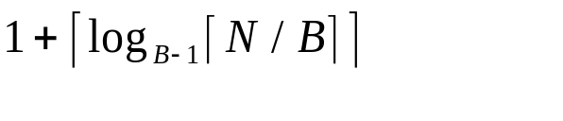
Evaluation Plan 2
Student: 500 pages, 80 tuples/page, 50 bytes/tuple
Take: 1000 pages, 100 tuples/page, 40 bytes/tuple
- 200 courses in table Take
- 1, 2, …, 40 in attribute Age
of table Student
Size of the buffer = 3 pages
(On-the-fly)
sname
Cost of Sorting = 2N * (# of passes)
where no. of passes=
(Sort-Merge Join)
T.sid=S.sid
(Write to
Temp T1)
(Write to
Temp T2)
cid=231
age > 20
Take T
Student S
(File scan)
(File scan)

Slide 33


Evaluation Plan 2
Student: 500 pages, 80 tuples/page, 50 bytes/tuple
Take: 1000 pages, 100 tuples/page, 40 bytes/tuple
- 200 courses in table Take
- 1, 2, …, 40 in attribute Age
of table Student
Size of the buffer = 3 pages
Cost of Reading T = 1000 pages
Size of T1 = 1000/200 = 5 pages
Cost of Writing T1 = 5 pages
(On-the-fly)
Cost of Reading S = 500 pages
Cost of Reading S = 500 pages
sname
Size of T2 = 500/2 = 250 pages
(Sort-Merge Join)
Cost of Writing T2 = 250 pages
T.sid=S.sid
Cost of Sorting T1
= 2*5*( )
= 20 pages
(Write to
Temp T1)
(Write to
Temp T2)
cid=231
age > 20
Cost of Sorting T2
= 2*250*( )
= 4000 pages
Take T
Student S
Cost of Merging = cost of reading T1 and T2
= 5 + 250 = 255 pages
(File scan)
(File scan)
Total cost = 1000 + 5 + 500 + 250 + 20 + 4000 + 255 = 6030 pages

Slide 34
Evaluation Plan 3
Student: 500 pages, 80 tuples/page, 50 bytes/tuple
Take: 1000 pages, 100 tuples/page, 40 bytes/tuple
- 200 courses in table Take
- 1, 2, …, 40 in attribute Age
of table Student
Size of the buffer = 3 pages
(On-the-fly)
sname
(On-the-fly)
age > 20
Assume that the tuples in Table Student are sorted
according to sid
(Sort-Merge
Join)
T.sid=S.sid
(Write to
temp T1)
Student S
cid=231
Take T
(File Scan)

Slide 35
Evaluation Plan 3
Student: 500 pages, 80 tuples/page, 50 bytes/tuple
Take: 1000 pages, 100 tuples/page, 40 bytes/tuple
- 200 courses in table Take
- 1, 2, …, 40 in attribute Age
of table Student
Size of the buffer = 3 pages
Cost of Reading T = 1000 pages
(On-the-fly)
Size of T1 = 1000/200 = 5 pages
sname
Cost of Writing T1 = 5 pages
(On-the-fly)
Cost of Sorting T1
= 2*5*( )
= 20 pages
age > 20
(Sort-Merge
Join)
Since S is sorted according to sid,
we do NOT need to sort S
T.sid=S.sid
(Write to
temp T1)
Student S
Cost of Merging
= Cost of Reading T1 and S
= 5 + 500 = 505 pages
cid=231
Take T
(File Scan)
Total cost = 1000 + 5 + 20 + 505 = 1530 pages

Slide 36
Example Schema
Student: 500 pages, 80 tuples/page, 50 bytes/tuple
Take: 1000 pages, 100 tuples/page, 40 bytes/tuple
- 200 courses in table Take
- 1, 2, …, 40 in attribute Age
of table Student
Size of the buffer = 3 pages
Join
  Simple-nested loop Join
  Block-nested loop Join
  Sort-Merge Join
  Index-Nested loop Join

Slide 37
Evaluation Plan 4
Student: 500 pages, 80 tuples/page, 50 bytes/tuple
Take: 1000 pages, 100 tuples/page, 40 bytes/tuple
- 200 courses in table Take
- 1, 2, …, 40 in attribute Age
of table Student
Size of the buffer = 3 pages
(On-the-fly)
Assume the following.
T is sorted according to cid
T has a clustered hash index on cid
S has an unclustered hash index on sid
sname
(On-the-fly)
age > 20
(Index Nested Loop
Join with Pipelining)
sid=sid
(Use Hash
Index on cid;
Do not write
Result to temp)
cid=231
Student S
(Hash Index on sid)
Assume that the (average) cost of reading a hash
index is 1.2 pages
Take T

Slide 38
Evaluation Plan 4
Student: 500 pages, 80 tuples/page, 50 bytes/tuple
Take: 1000 pages, 100 tuples/page, 40 bytes/tuple
- 200 courses in table Take
- 1, 2, …, 40 in attribute Age
of table Student
Size of the buffer = 3 pages
Size of the temp result = 1000/200 = 5 pages
Cost of Reading T with Hash Index
= Cost of Reading Hash Index + Cost of Reading T
containing tuples with cid = 231
= 1.2 + 5 = 6.2 pages
(On-the-fly)
sname
(On-the-fly)
age > 20
No. of tuples in T with cid = 231
= 100*5 = 500
(Index Nested Loop
Join with Pipelining)
Cost of Index Nested Loop Join
= Cost of Reading S with Hash Index
= 500*(1.2+1)
= 1100 pages
sid=sid
(Use Hash
Index on cid;
Do not write
Result to temp)
cid=231
Student S
(Hash Index on sid)
Total cost = 6.2 + 1100 = 1106.2 pages
Take T

Slide 39
Outline
Introduction
Materialization and On-the-fly
Join over Two Tables
Join over Multiple Tables

Slide 40
Join over Multiple Tables
Relational Algebra Equivalences
Left-Deep Plan

Slide 41
Relational Algebra Equivalences
Two relational algebra expressions are said to be equivalent if on every legal database instance the two expressions generate the same set of tuples
  Note: order of tuples is irrelevant
An equivalence rule says that expressions of two forms are equivalent
  Can replace expression of first form by second, or vice versa

Slide 42



Equivalence Rules
1. Conjunctive selection operations can be deconstructed into a sequence of individual selections.
2. Selection operations are commutative.
3. Only the last in a sequence of projection operations is needed, the others can be omitted.
4. Selections can be combined with Cartesian products and theta joins
  σ_{θ}(E₁ X E₂) = E₁ _{θ} E₂
  σ_{θ1}(E₁ _{θ2} E₂) = E₁ _{θ1∧ θ2} E₂

Slide 43
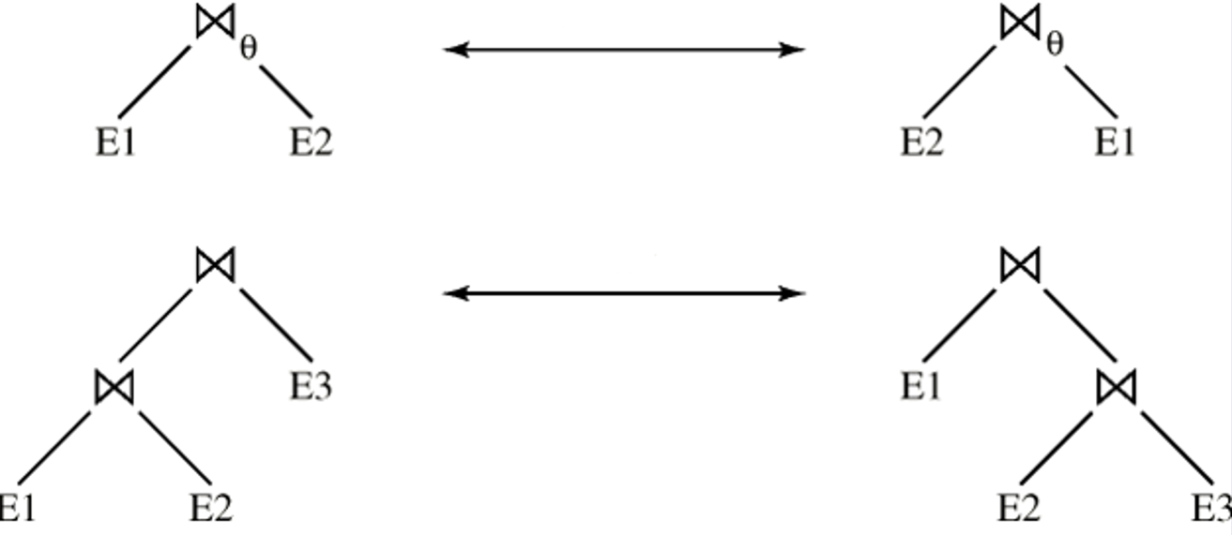
Equivalence Rules (Cont.)
5. Theta-join operations (and natural joins) are commutative.
E_{1 θ} E₂ = E₂ _{θ} E₁
6. Natural join operations are associative:
(E₁ E₂) E₃ = E₁ (E₂ E₃)

Slide 44
Join over Multiple Tables
Relational Algebra Equivalences
Left-Deep Plan

Slide 45
Left-Deep Plans
For multi-relation query, plan space can be very large and must be pruned.
  As # of joins increases, # of alternative plans grows rapidly
D
D
B
D
C
C
A
C
A
B
A
B

Slide 46
Left-Deep Plans
Typically, only left-deep trees (the right child of each join node is a base table) are considered.
  Significantly fewer, but still lots -- n!(24 for n = 4)
D
C
A
B

Slide 47
Left-Deep Plans
  Left-deep trees allow us to generate fully pipelined plans.
    Intermediate results not written to temporary files.
    Not all plans from left-deep trees are fully pipelined (e.g., sort-merge join).
D
C
A
B

Slide 48
To join A, B, C
Pass 1
A
B
C
Pass 2
A
B
A
C
B
C
Pass 3
C
B
A
A
B
A
C
C
B

Slide 49
Enumeration of Left-Deep Plans
Enumerated using N passes (if N relations joined):
  Pass 1: Find best 1-relation plan for each relation.
  Pass 2: Find best way to join result of each 1-relation plan (as outer) to another relation. (All 2-relation plans.)
  Pass N: Find best way to join result of a (N-1)-relation plan (as outer) to the N’th relation. (All N-relation plans.)
For each subset of relations, retain only:
  Cheapest plan overall

Slide 50
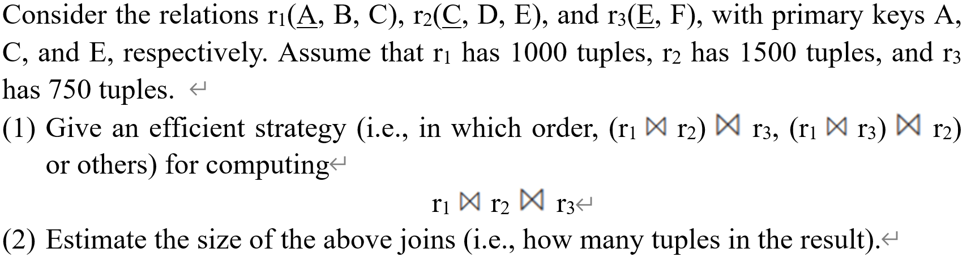
Exericse

Slide 51
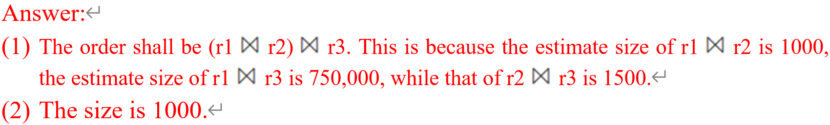
Exericse

